Slide 1


Slide 2
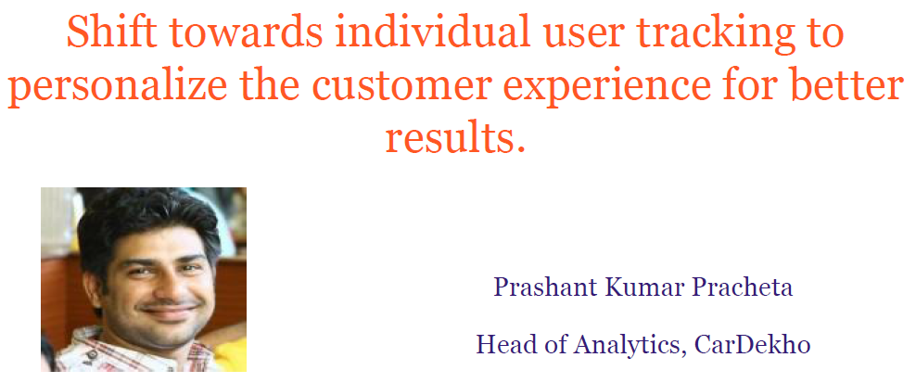
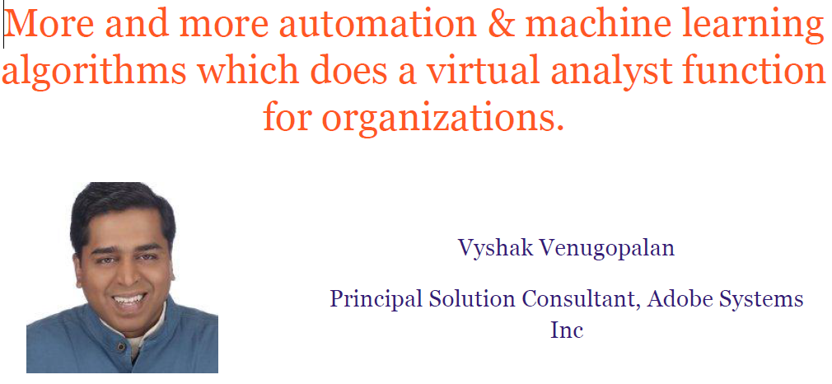
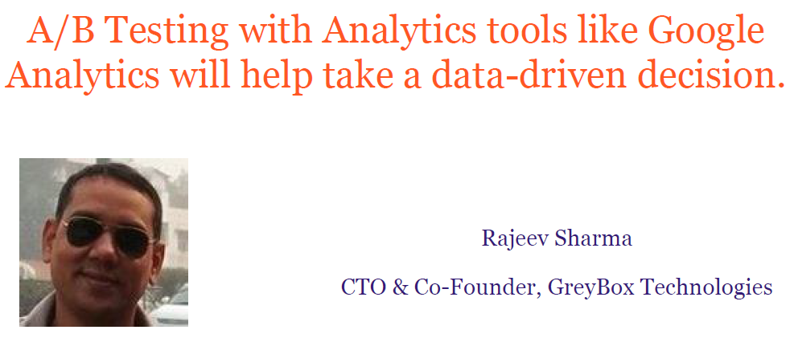
Why
Web Analytics ?
improve online results, whatever they are...

Slide 3
Web Analytics
Web analytics is the measurement, collection, analysis and reporting of internet data for purposes of understanding and analysing for decision making.
What type of data can be collected from web site visits?
How can this data be collected?
What are the potential problems with collecting data?
What analysis can be done on this data?
What information do you want about how your website is being used?
What data can you collect from your website?
How can you analyse the data?
Can this give you the information you want?

Slide 4

What kind of information can you find out?
How people find your site :
What search engine do they use?
What search terms do they use?
What sites refer visitors to my site?
How people navigate your site
What content are they most interested in?
Where do people drop out of the site?

Slide 5
What kind of information can you find out?
How people become customers
What part of my web site is most effective at generating sales?
What are the conversion rates (number of sales) based on traffic from different sites?
Where are the customers located?

Slide 6
Metrics for Measuring web performance
Metrics:
It is a good idea to identify metrics which you can track to access if your web site is working.
Which metrics are suitable depends on the nature of the site:
eCommerce, Social Networking

Slide 7
Key Metrics
General
Views
Visits
Bounce Rate
Conversion Rate
Time on Site
New vs. Returning Visitors
Depth of Visit
Generally trends will be more interesting than absolute numbers.
Non Commerce Sites
Loyalty
How much content is consumed
Engagement of web applications (RIA)

Slide 8
Some Examples of metrics
Conversion Rate:
Did visitors do what you wanted them to do?
Buy something, download a catalogue, join your mailing list, watch a video ?
Average order size (for e-commerce).
Average time spent per visit for other types of site.
Abandonment Rate
Number of shopping carts abandoned.
Number of registrations not completed.
Content Rating by visitors.

Slide 9
Exercise
What metrics do you think the college could use for our college web site?

Slide 10
Remember all of this is complex information.
Need to consider whether you can collect the data to generate this information.

Slide 11

How is data collected?
Script Based Tracking
Server logs

Slide 12

How is data collected?
Classified into three categories, depending on the mining goals and the information garnered:
web structure mining - extracts patterns from the linking structures between pages, and presents the web as a directed graph in which the nodes represent pages and the directed edges represent links
web usage mining - mines user activity patterns gathered from the analysis of web log records, in order to understand user behavior during website visits
web content mining - and mines valuable information from web content

Slide 13
Script Based Tracking
Some code (normally Java script) is added to each page.
This code can collect additional information and send it back to the server.
for example: Information about the screen size, partial form completion.
The page tagging service manages the process of assigning cookies to visitors.
Page tagging can report on events which do not involve a request to the web server
Eg. such as interactions within Flash movies or partial form completion
The technology is usually provided as part of a hosted solution and website owners can access real time reports online without needing any additional hardware or software in-house.

Slide 14
Server logs
These are log files which contain a history of activity on a web server.
Data saved generally includes:
IP address of the client
User name if logging on is necessary.
Date and Time
Page of file requested
Number of bytes returned,
Browser the client used
URL of page which contains the link
Any cookies.
Any errors

Slide 15
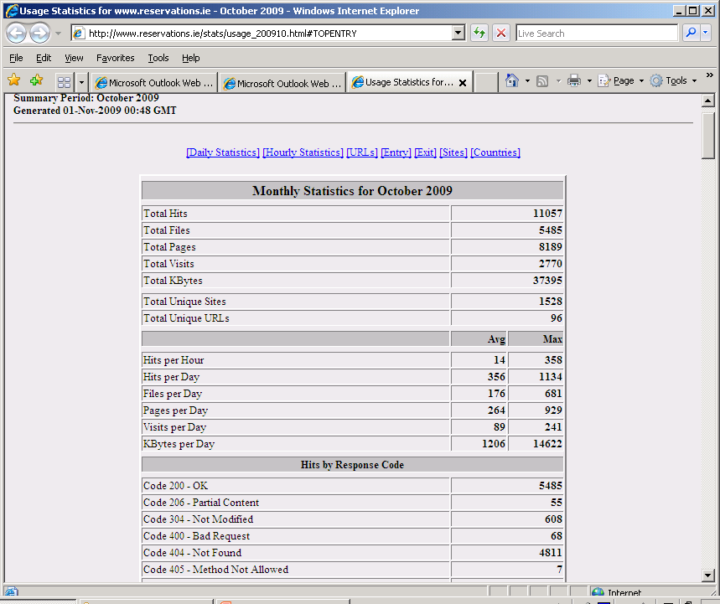

Slide 16
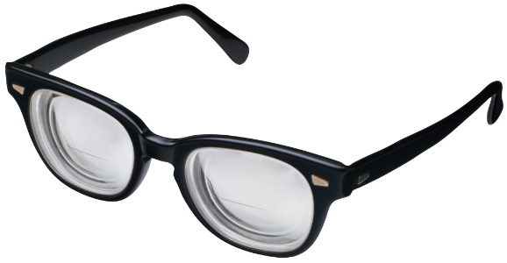
Analysis
Need to get beyond basic statistics in order to understand the data.
May need to analyse data based on different dimensions.
E.g. data accessed, geographic region, total spend, traffic type, browser used, new verus repeat visitors.
May use external data in order to interpret the data.
E.g. Any external marketing campaigns.

Slide 17
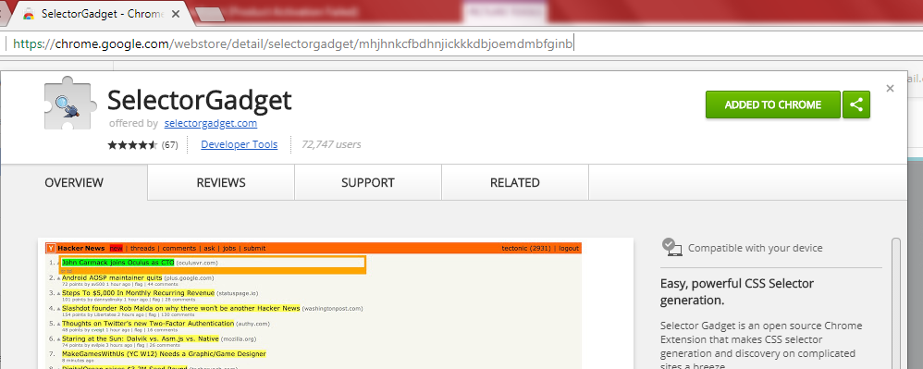
Prerequisite before starting with R
URL
Click here

Slide 18
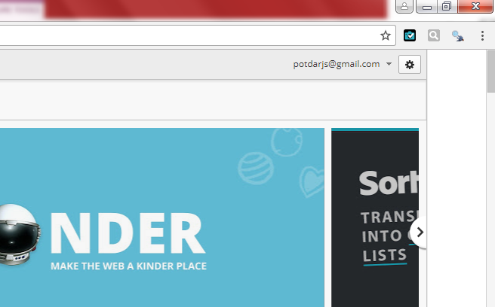
Prerequisite before starting with R
Selector Gadget Tool will appear here

Slide 19

Starting with R
Install required package
“rvest”

Slide 20
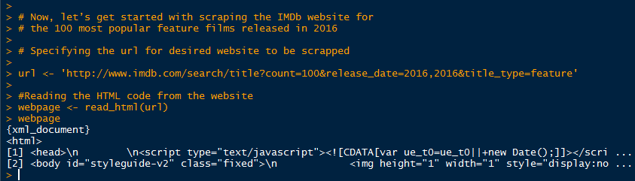
Web Analytics with R –
Reading HTML code from the IMDb website
Specify URL
Read HTML Code
HTML doc

Slide 21
Aim…
We’ll be scraping the following data from IMDb website.
# • Rank: The rank of the film from 1 to 100
# • Title: The title of the feature film.
# • Description: The description of the feature film.
# • Runtime: The duration of the feature film.
# • Genre: The genre of the feature film,
# • Rating: The IMDb rating of the feature film.
# • Metascore: The metascore on IMDb website for the feature film.
# • Votes: Votes cast in favor of the feature film.
# • Gross_Earning_in_Mil: The gross earnings of the feature film in millions.
# • Director: The main director of the feature film. Note, in case of multiple directors, I’ll take only the first.
# • Actor: The main actor of the feature film. Note, in case of multiple actors, I’ll take only the first.

Slide 22
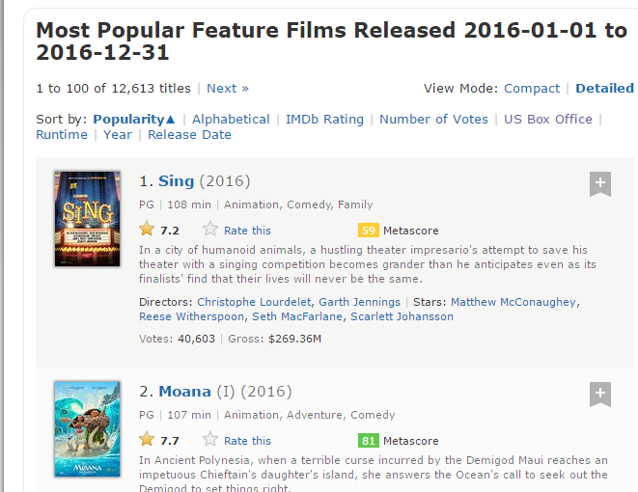
Using the Selector Gadget to know CSS selector
Open the below Link in Google Chrome
http://www.imdb.com/search/title?count=100&release_date=2016,2016&title_type=feature

Slide 23
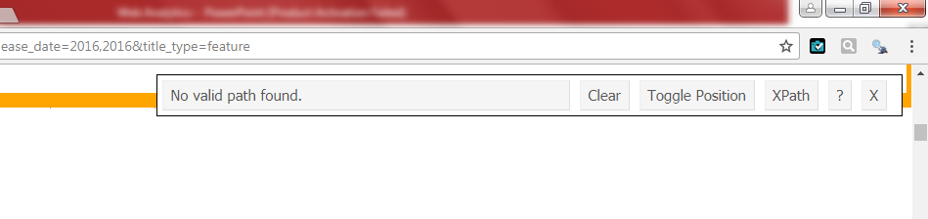
Using the Selector Gadget to know CSS selector
Open the below Link in Google Chrome
http://www.imdb.com/search/title?count=100&release_date=2016,2016&title_type=feature
Click on Selector Gadget
This window will pop up

Slide 24
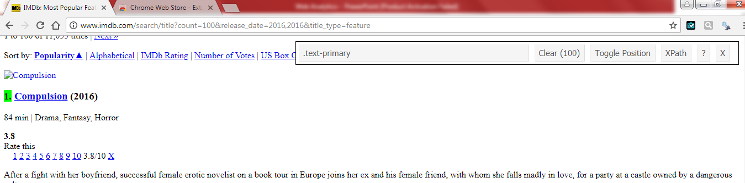

Using the Selector Gadget to know CSS selector
Open the below Link in Google Chrome
http://www.imdb.com/search/title?count=100&release_date=2016,2016&title_type=feature
Select the Ranking Field with cursor. It will get highlighted
Such text will appear here. Copy this CSS selector

Slide 25
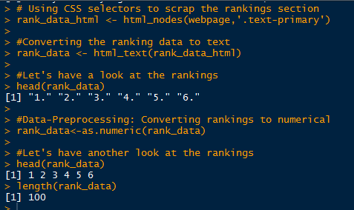
Scrap the Ranking Section using CSS Selector
Paste the CSS selector
Getting Rank data
Rank data in raw form
Processing it

Slide 26
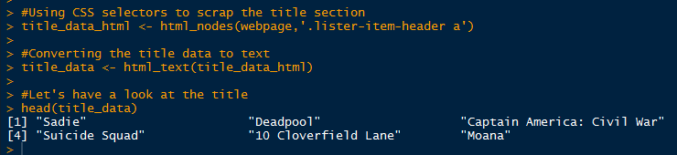
Scrap the Title Section using CSS Selector
CSS selector
Getting Rank data
Title data

Slide 27
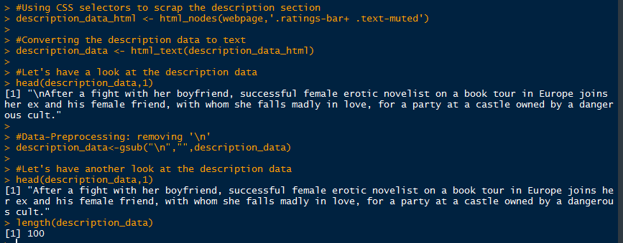
Scrap the Description Section using CSS Selector

Slide 28
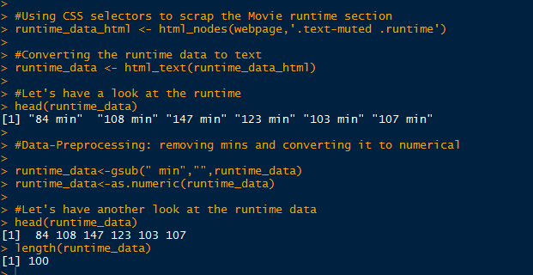
Scrap the Runtime Section using CSS Selector

Slide 29
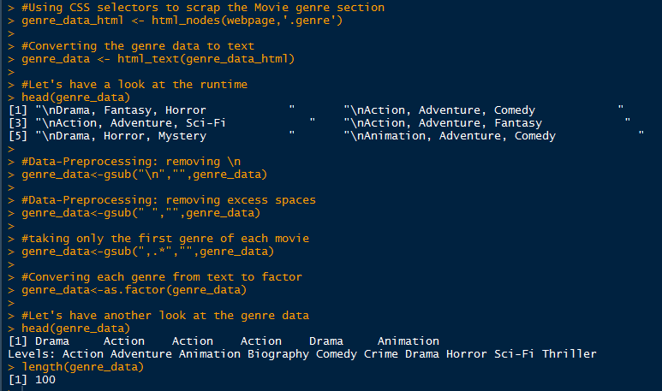
Scrap the Genre Section using CSS Selector

Slide 30
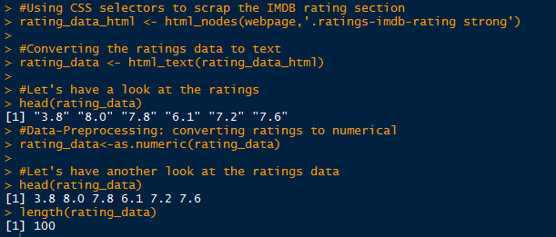
Scrap the Rating Section using CSS Selector

Slide 31
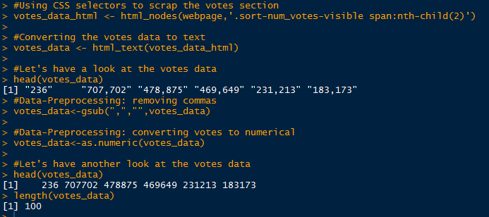
Scrap the Votes Section using CSS Selector

Slide 32
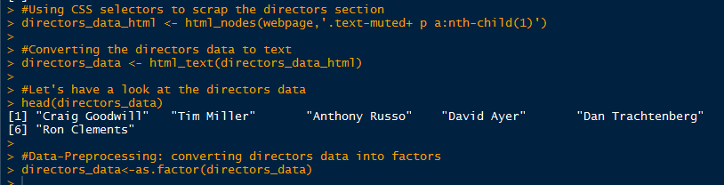
Scrap the Directors Section using CSS Selector

Slide 33
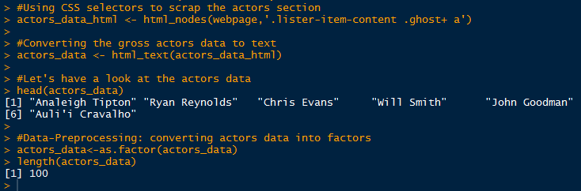
Scrap the Actor Section using CSS Selector

Slide 34
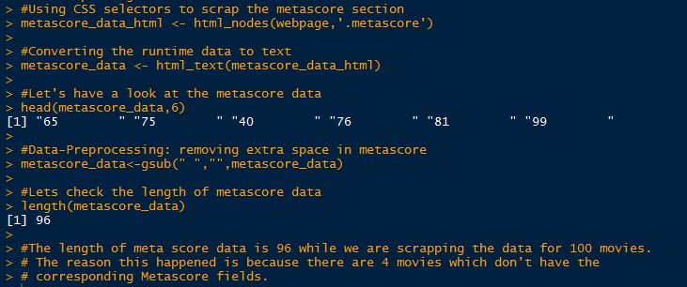
Scrap the Metascore Section using CSS Selector

Slide 35
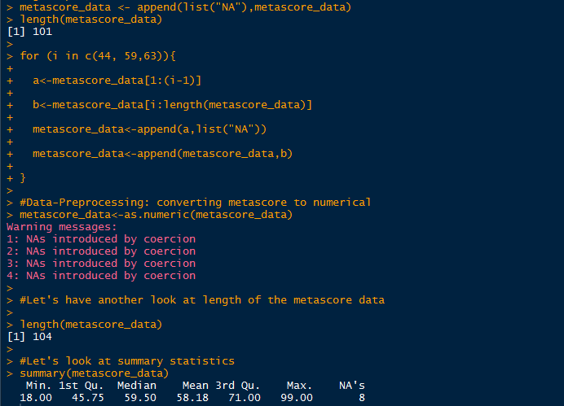
Scrap the Metascore Section using CSS Selector

Slide 36
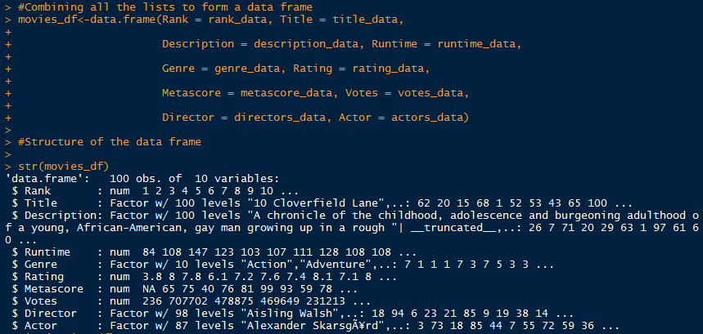
Combining the captured data in to a single data frame

Slide 37

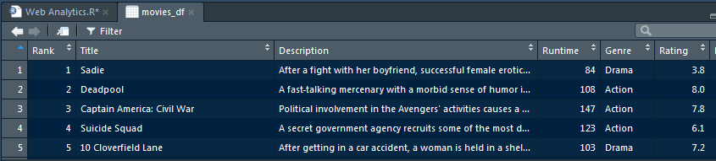
Now we have successfully scrapped the IMDb website for the 100 most popular feature films

Slide 38

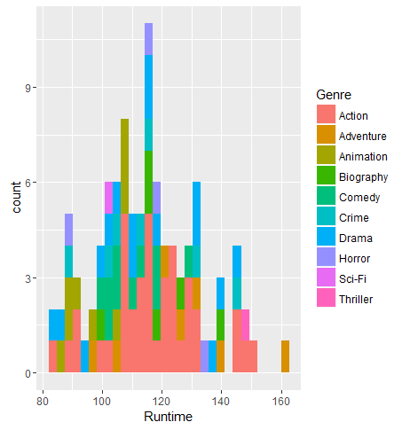
Analyzing the scrapped data from the web

Slide 39

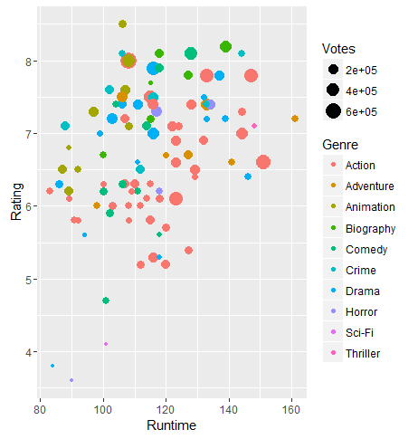
Analyzing the scrapped data from the web

Slide 40
Analyzing the scrapped data from the web-
get resources from servers into R
Readymade files e.g. csv, text
PDF
FTP (file transfer protocol)
HTTP ( Hyper Text Transfer Protocol)
gather links, lists and tables from HTML documents
HTML forms
URLs to access multiple pages
Connections via HTTPS
Using cookies
Retrieving data from APIs (Web Application Programing Interface)
Authentication with OAuth (twitter / facebook)
JavaScript-enriched pages

Slide 41
Web Analytics – Understanding HTTP
http://www.w3.org:80/People/Berners-Lee/#Bio
http://128.30.52.37/People/Berners-Lee/#Bio
http:// www.w3.org:80/ People/Berners-Lee/#Bio
scheme that defines the protocol that is used to communicate between client/application and server
The hostname provides the name of the server where the resource of interest is stored. The hostname along with the port component tell the
client at which door it has to knock in order to get access to the requested resource. Every hostname also has a machine-readable IP addres
The path determines the location of the requested resource on the server. It works like paths on any conventional file system where files are nested in folders that may again be nested in folders and so on. Path segments are separated by slashes (/).
HTTP (Hyper Text Transfer Protocol), FTP (File Transfer Protocol), Post Office Protocol
(POP) for email retrieval, SMTP (Simple Mail Transfer Protocol) or IMAP (Internet Message
Access Protocol) for email storage and retrieval

Slide 42
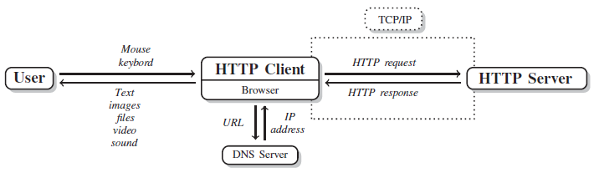
Web Analytics – Understanding HTTP
Hyper Text Transfer Protocol define standard vocabulary and procedures for clients and servers to talk about specific tasks—retrieving or storing documents, files, messages, and so forth. They are subsumed under the label application layer.
The location of websites and other web content are identified by Uniform Resource Locators (URLs). They are not part of HTTP but make communication via HTTP and Several lines of the server response have been omitted for purposes of presentation. other protocols straightforward for users – http://www.google.com
The HTTP client first translates the host URL into an IP address and then establishes a connection to the server on the default HTTP port (port 80). The port can be imagined as a door at the server’s house where the HTTP client knocks.
TCP (Transmission Control Protocol) and IP (Internet Protocol) take care of reliable data transfer between computers in the network

Slide 43
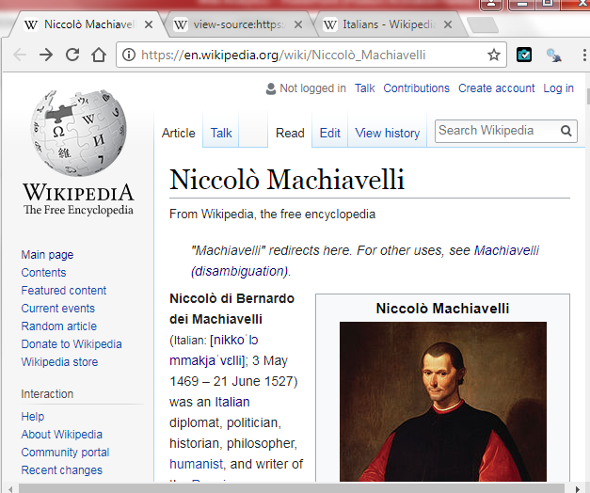
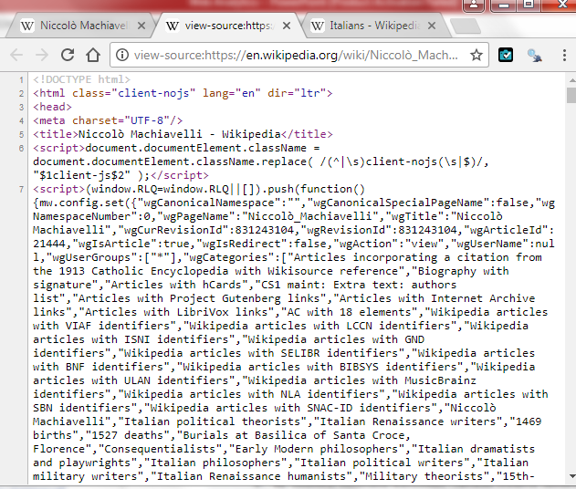
Right Click on Screen and View Page Source

Slide 44
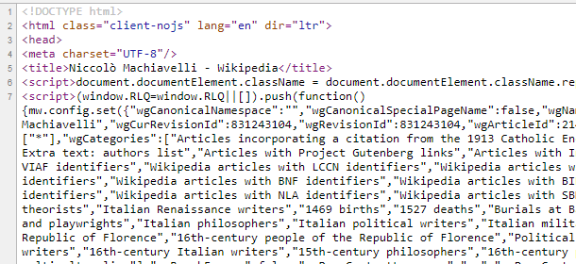

Slide 45
Web Analytics – Install Packages
Install below packages and load library
RCurl
httr
libcurl
Rselenium
tidyverse
jsonlite
XML
plyr
rvest
Rcrawler

Slide 46
Web Analytics – Tasks
1. Information identification
2. Choice of strategy
3. Data retrieval
4. Information extraction
5. Data preparation
6. Data validation
7. Debugging and maintenance
8. Generalization
The art of scraping lies in cleverly combining and redefining these tasks

Slide 47
Web Analytics – Readymade Files
In some situations we find data ready for download in txt, csv, pdf, xls or jpeg…
http://www.elections.state.md.us/elections/2012/election_data/index.html
Suppose we want to download these files for analyses.
The links to the CSV files are scattered across several tables on the page. We are only interested in some of the documents.
In order to retrieve the desired files, we want to proceed in three steps.
1. We identify the links to the desired files.
2. We construct a download function.
3. We execute the downloads.

Slide 48
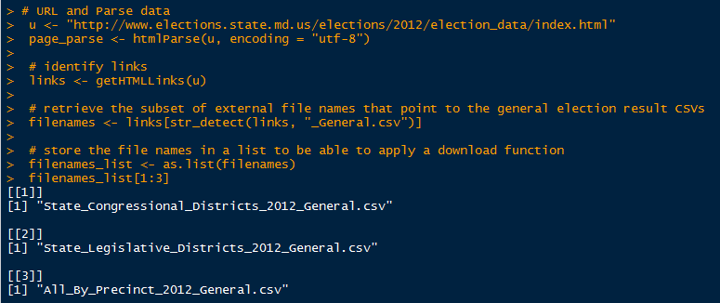
Web Analytics – Readymade Files
Prepare File names

Slide 49
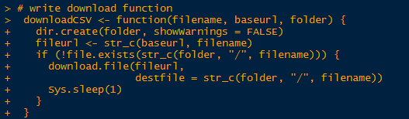
Web Analytics – Readymade Files
Write Download Function
Set up a function to download all the files and call the function downloadCSV().
Function has three arguments.
filename refers to each of the entries in the filenames_list object.
baseurl specifies the source path of the files to be downloaded
folder where the files are stored in our local drive
Tweak the download by adding (1) a condition which ensures that the file download is only performed if the file does not already exist in the folder using the file.exists() function and (2) a pause of 1 second between each file download

Slide 50
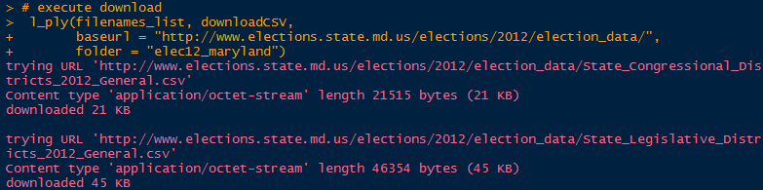
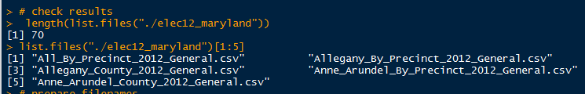
Web Analytics – Readymade Files
Apply the function to the list of CSV file names
The function takes a list as main argument and passes each list element as argument to the specified function, in our case downloadCSV().
Pass further arguments to the function
For baseurl we identify the path where all CSVs are located.
With folder we select the local folder where want to store the files

Slide 51
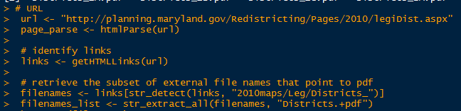
Web Analytics – Retrieve PDF
The maps are available at the Maryland Department of Planning’s website: http://planning.maryland.gov/Redistricting/2010/legiDist.aspx
The download function downloadPDF() now relies on getBinaryURL(). We allow for the use of a curl handle. We cannot specify a destination file in the getBinaryURL() function, so we store the raw data in a pdffile object first and then pass it to writeBin(). This function writes the PDF files to the specified folder

Slide 52
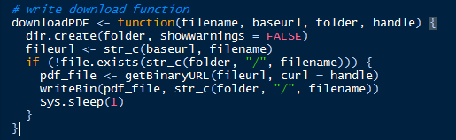
Web Analytics – Retrieve PDF
Download Function
The download function downloadPDF() now relies on getBinaryURL(). We allow for the use of a curl handle. We cannot specify a destination file in the getBinaryURL() function, so we store the raw data in a pdffile object first and then pass it to writeBin(). This function writes the PDF files to the specified folder

Slide 53
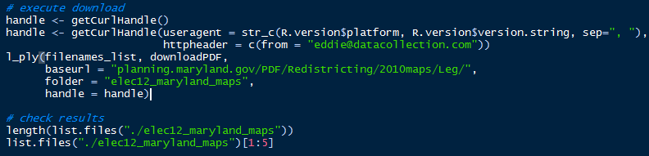
Web Analytics – Retrieve PDF
Executing the Function with Handle
Execute the function with a handle that adds a User-Agent and a From header field to every call and keeps the connection alive. We could specify further options if we had to deal with cookies or other HTTP specifics.

Slide 54
Web Analytics – Downloading multiple files from an FTP index
An alternative network protocol to HTTP for pure file transfer, the File Transfer Protocol (FTP)
Downloading files from FTP servers is a rewarding task for data wranglers because FTP servers host files, nothing else
ftp://cran.r-project.org/
Say we want to download all CRAN task view HTML files for closer inspection. They are stored at ftp://cran.r-project.org/pub/R/web/views/.
Downloading strategy
1. We identify the desired files.
2. We construct a download function.
3. We execute the downloads.

Slide 55
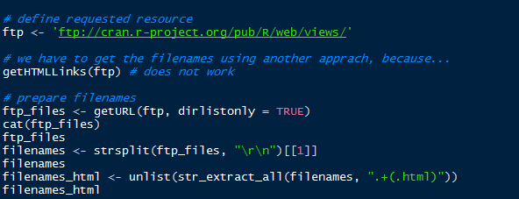


Web Analytics – Downloading multiple files from an FTP index

Slide 56
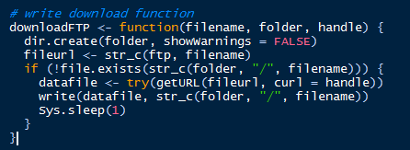
Web Analytics – Downloading multiple files from an FTP index
Write Download Function

Slide 57
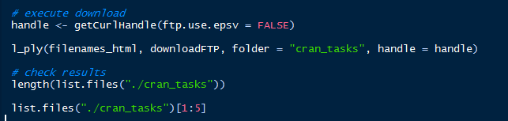

Web Analytics – Downloading multiple files from an FTP index
Executing the Function with Handle

Slide 58
Web Analytics – Manipulating URLs to access multiple pages
directories on a web server are comparable to the folders on our local hard drive
directories of the website follow specific systematics, we can make use of this fact and apply it in web scraping by manipulating the URL of a site
organization’s press releases under the heading “News” at http://www.transparency.org/news/pressreleases/
On selectin the year 2011 from the dropdown menu notice how the statement year/2011 is appended to the URL.
When clicked on “Next” at the bottom of the page, the URL is appended with the statement P10

Slide 59
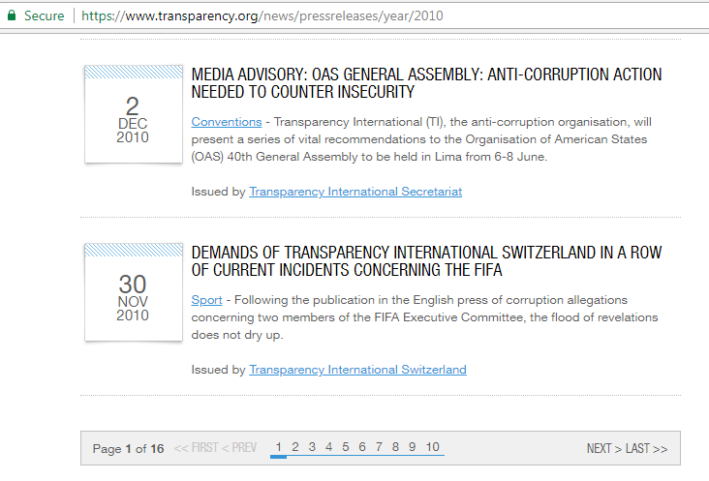
Web Analytics – Manipulating URLs to access multiple pages
Base URL
Multiple Pages

Slide 60
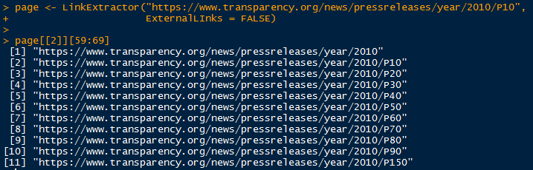
Web Analytics – Manipulating URLs to access multiple pages
We use the Rcrawler Package
Base URL with one Page No.
Multiple Pages

Slide 61
Web Analytics – to gather links, lists and tables from HTML doc
XML Package - commands that considerably ease information extraction tasks in the web-scraping workflow. The functions readHTMLTable(), readHTMLList(), and getHTMLLinks() help extract data from HTML tables, lists, and internal as well as external links
We illustrate their functionality with a Wikipedia article on Niccol`o Machiavelli, an “Italian historian, politician, diplomat, philosopher, humanist, and writer” (Wikipedia 2014).

Slide 62

Web Analytics – to gather links, lists and tables from HTML doc
XML Package - getHTMLlinks() which serves to extract links from HTML documents
The first object stores the URL for the article (mac_url),
the second stores the source code (mac_source),
the third stores the parsed document (mac_parsed),
and the fourth and last object (mac_node) holds only one node of the parsed document, namely the <p> node that includes the introductory text.

Slide 63
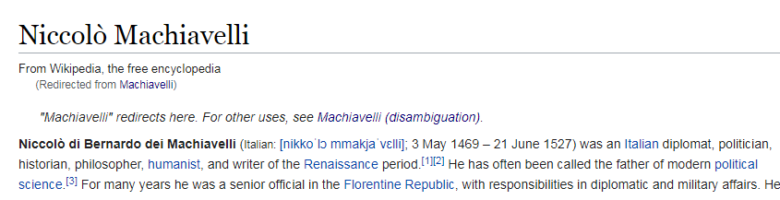
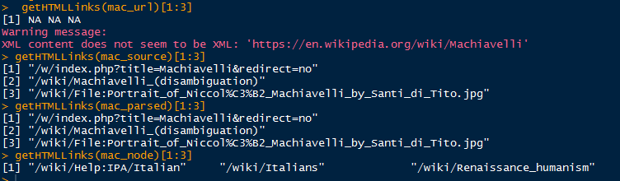
Web Analytics – to gather links

Slide 64
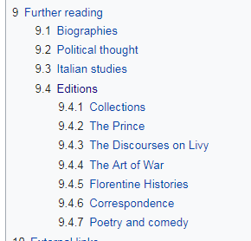
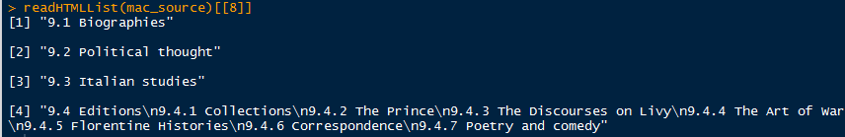
Web Analytics – to gather lists

Slide 65
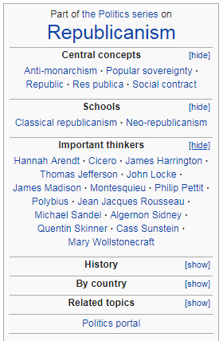
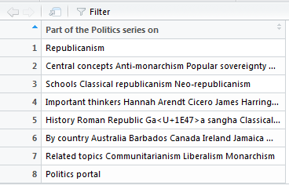
Web Analytics – to gather tables

Slide 66
Web Analytics – Dealing with HTML Forms
Filling out forms in the browser and handling them from within R differs in many respects, because much of the work that is usually done by the browser in the background has to be specified explicitly. Using a browser, we
Using a browser, we 1. fill out the form, 2. push the submit, ok, start, or the like! button. 3. let the browser execute the action specified in the source code of the form and send the data to the server, 4. and let the browser receive the returned resources after the server has evaluated the inputs. | In scraping practice, things get a little more complicated. We have to 1. recognize the forms that are involved, 2. determine the method used to transfer the data, 3. determine the address to send the data to, 4. determine the inputs to be sent along, 5. build a valid request and send it out, and 6. process the returned resources

Slide 67
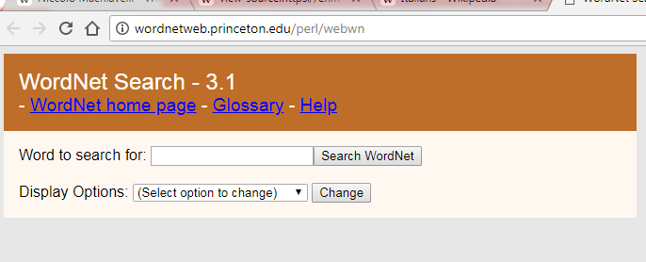
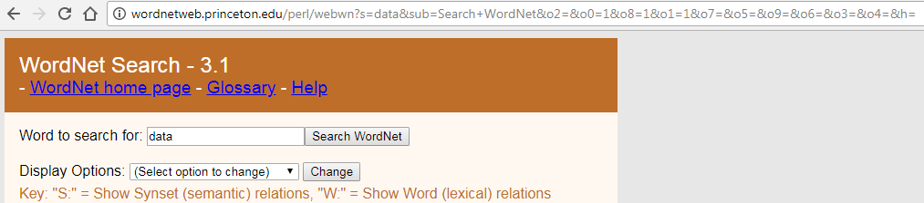
Web Analytics – Dealing with HTML Forms
type in a word, for example, data. Hitting the Search WordNet button results in a change to the URL which now contains 13 parameters.

Slide 68
Web Analytics – Dealing with HTML Forms
# basic procedure with RHTMLForms
# use getHTMLFormDescription() on the URL where the HTML form is located and save its results in an object -- let's call it forms
# use createFunction() on the first item of the forms object and save the results in another object, say form_function
# formFunction() takes input fields as options to send them to the server and return the result.

Slide 69

Web Analytics – Dealing with HTML Forms
Install Package “RHTMLFORMS” and load to library

Slide 70


Web Analytics – Dealing with HTML Forms
gathering the form description information and creating the form function.
Having created formFunction(), we use it to send form data to the server and retrieve the results.

Slide 71

Web Analytics – HTTP authentication
Not all places on the Web are accessible to everyone
we try to access the “solutions” section at www.rdatacollection.com/materials/solutions.
When trying to access the resources with our browser, we are confronted with a login form
we can pass username and password to the server with libcurl’s userpwd option

Slide 72

Web Analytics – Connections via HTTPS
we do not have to care much about the encryption and SSL negotiation details, as they are handled by libcurl in the background by default.
https://www.icpsr.umich.edu/icpsrweb/ICPSR/ssvd/search offers a fielded search for variables

Slide 73

Web Analytics – Cookies
Cookies are used to allow HTTP servers to re-recognize clients,
All we have to do is to turn it on and keep it running across several requests with the use of a curl handle—setting and sending the right cookie at the right time is managed in the background.
The general approach for using cookies with R is to rely on RCurl’s cookie management by reusing a handle with activated cookie management, like the one specified above, in subsequent requests

Slide 74
Web Analytics – Cookies
In a Web browser, we visit the page http://www.wateroffice.ec.gc.ca/graph/graph_e.html?mode=text&stn=05ND012&prm1=3&syr=2012&smo=09&sday=15&eyr=2012&emo=09&eday=18. Before allowing us access to the data, the Web site presents us with a disclaimer page. We have to click on the I Agree button and then we are forwarded to a page with the actual data.
What happens when we click on the I Agree button? That sets a cookie. After that, we include that cookie in each request to that server and this confirms that we have agreed to the disclaimer. The Web server will process each request containing the cookie knowing we have agreed and so give us the data. So we need to first make a request in R that emulates clicking the I Agree button. We have to arrange for that request to recognize the cookie in the response and then use that cookie in all subsequent requests to that server

Slide 75
Web Analytics – Cookies
We create the curl handle object with
library(RCurl) curl = getCurlHandle(cookiefile = "", verbose = TRUE)
The disclaimer page is a POST form. We send the request to http://www.wateroffice.ec.gc.ca/include/disclaimer.php with the parameter named disclaimer_action and the value "I Agree“
txt = getForm("http://www.wateroffice.ec.gc.ca/graph/graph_e.html",
mode = "text", stn = "05ND012", prm1 = 3, syr = "2012", smo = "09",
sday = "15", eyr = "2012", emo = "09", eday = "18", curl = curl)
The result should contain the actual data.
library(XML) tbl = readHTMLTable(txt, asText = TRUE)
We can find the number of rows and columns in each table with
sapply(tbl, dim)

Slide 76

Web Analytics – Retrieving data from API
Generally, APIs encompass tools which enable programmers to connect their software with “something else.”
Interfaces with web applications
The reason why APIs are of importance for web data collection tasks is that more and more web applications offer APIs which allow retrieving and processing data.

Slide 77
Web Analytics – Retrieving data from API
Web APIs allow programmable access to an organization’s assets (e.g. its data) via a defined set of Hypertext Transfer Protocol (HTTP) messages. In a nutshell, accessing data from a web API is very similar to visiting a website; in both cases, you specify a url and information is sent to your machine. With websites, the URL you enter sends code (HTML, CSS, JavaScript) to your browser, which interprets and displays the website’s content. When using a web API, you give R a URL to request information from and the API sends you back a response, usually in the form of JavaScript Object Notation (JSON) or Extensible Markup Language (XML). Thus, in many cases, accessing data from web APIs with R involves just two steps - constructing the URL query that will serve as the API request, and processing the subsequent response message the API sends back.

Slide 78


Web Analytics – Retrieving data from API
Github is an online code repository and has APIs to get live data on almost all activity.
Below some examples from a well known R package and author:

Slide 79


Web Analytics – Retrieving data from API
A single public API that shows location, status and current availability for all stations in the New York City bike sharing imitative

Slide 80
Web Analytics – Authentication with OAuth (twitter / facebook)
# Twitter
# The twitter API requires OAuth2 authentication.
# we need
consumer key
consumer secret
access token
#Create your own application key at https://dev.twitter.com/apps
e.g.

Slide 81

Web Analytics – Authentication with OAuth (twitter / facebook)
# Using basic auth and access token

Slide 82


Web Analytics – Authentication with OAuth (twitter / facebook)
Actual API call

Slide 83
Web Analytics: Tools and Case Studies
Tools
VisiStat - www.visistat.com
Web Analytics Case Studies
Communications Provider - TuVox.com
Online Retailer - TicketsByInternet.com
Winery & Entertainment Venue - The Mountain Winery
Non-Profit Organization - SFBallet.org
Public Relations & Media Agency - BLASTmedia
Technology Provider for Real Estate Professionals - Pullan.com
Real Estate Agency - Intero Real Estate
Start-Up Online Business - GuruPrint.com

Slide 84


Slide 85


Slide 86
Thank you…

